Slide 1
Intro to Machine Learning
Analysis of skillsets for Data Scientist,ML Engineer,Data Engineer
Joel Varghese
MTech CSE,DS&AI

Slide 2
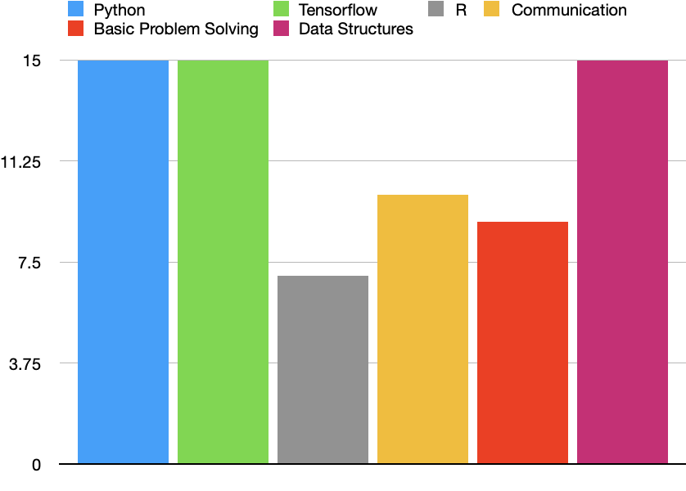
ML Engineer
Skills Required
Python,Tensorflow,R,communication,Basic Problem solving,Data structures

Slide 3
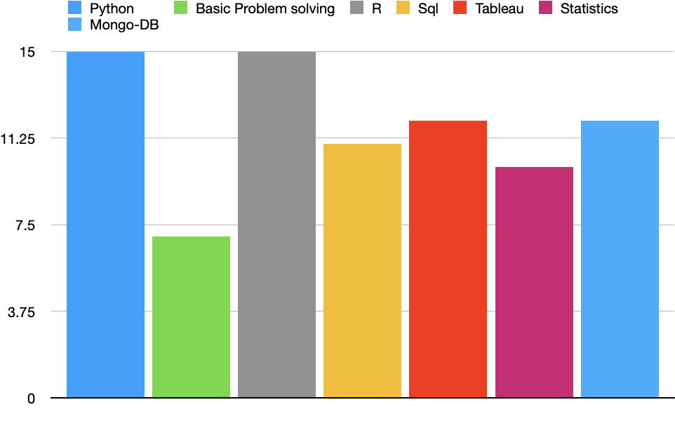
Data Scientist
Skills Required
Python,Basic Problem solving,R,Sql,
Tableau,Statistics,Mongo-DB

Slide 4
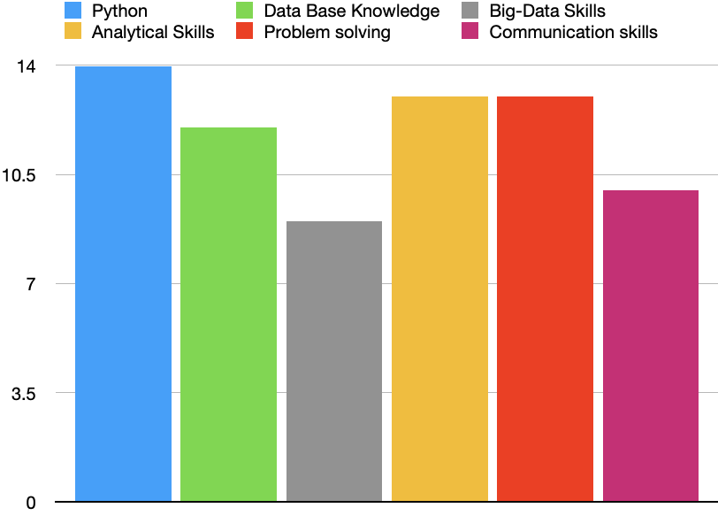
Data Engineers
Skills Required
Python,Data Base Knowledge,Big-Data Skills,Analytical Skills,Problem solving,Communication skills

Slide 5
Thank You

